Slide 1
Introduction to Mininet-WiFi exercise
Course 34351 Access- and Home Networks

Slide 2
How can we evaluate network performance?
Measurements on a real (live) network?
Measurements on a test bed?
Build simulation (software) models of protocols and network nodes and run simulations
Emulate node functionality in software

Slide 3

Measurements on a live network: Pros and cons
Pros:
Results are real and represents actual traffic
Cons:
No control over traffic
Results generally not reproducible
Very difficult to test alternative configurations, topologies, etc.
Source: https://www.pcworld.com/article/533069/obama_web_traffic.html
Notes:
Re: Obama’s 1st inauguration: January 20, 2009

Slide 4
Measurements on a test bed: Pros and cons
Pros:
Control of network traffic and results are normally reproducible on identical test beds
Easier to test different configurations, topologies, ... than on a live network
Cons:
May be difficult to change/modify software on network nodes
May be expensive to set up for a bigger network
Notes:
Re: Obama’s 1st inauguration: January 20, 2009

Slide 5
Measurements using simulations
Pros:
Possible to develop very detailed models
Full control of everything
Results are 100% reproducible
Cons:
Can take a long time to develop many (complicated) models
Impossible to implement every functionality in the network => Models are not complete
Results are (usually) not identical to real systems
But if you’ve carefully selected what to implement and what to leave out, you can still get useful results
Especially if you use simulations to compare configurations, etc.

Slide 6
Emulation
Pros:
You use actual code, e.g., actual Linux drivers
Easy to test the performance of an updated driver
Results are (almost) reproducible
A powerful computer can emulate a large network (i.e. less resources than a test bed)
Cons:
You use actual code, e.g., actual Linux drivers
Bugs in the code affects your results
Still some abstractions, e.g., models of communication links
Very large networks may require a big computer (but still cheaper than a test bed)
Often developed for a specific area of research

Slide 7
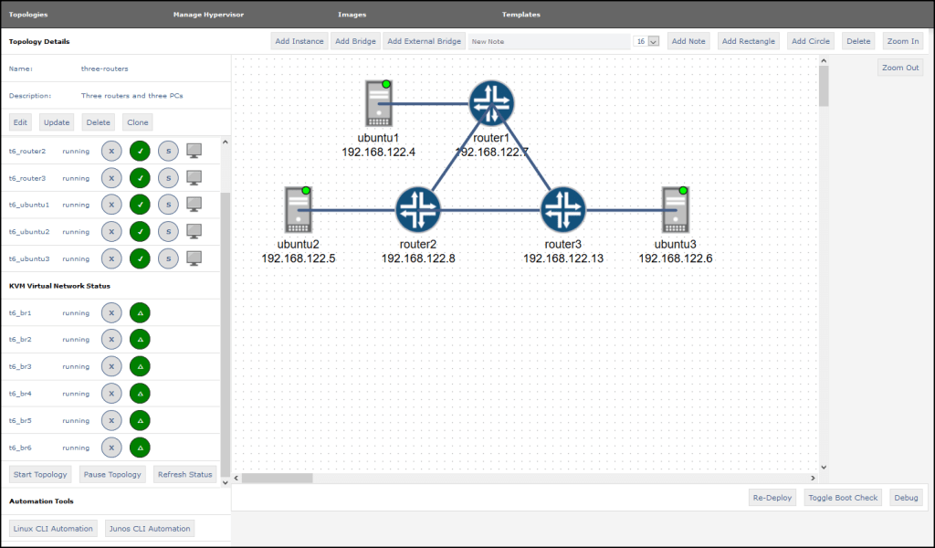
Network emulator
Notes:
Jupyter Wistar

Slide 8
Mininet
“Mininet is a network emulator which creates a network of virtual hosts, switches, controllers, and links. Mininet hosts run standard Linux network software, and its switches support OpenFlow for highly flexible custom routing and Software-Defined Networking.”
Source: www.mininet.org

Slide 9
Mininet (2)
Originally designed for research in Software Defined Networking and OpenFlow
Based on process abstraction in Linux and network namespaces
Process ≈ Code + Data in memory (isolated from other processes by the OS)
Traditional OS-approach for networking: All processes share
Network interfaces
Routing tables
ARP tables
Linux Network Namespace: Each process has own interfaces, routing tables and ARP tables
So one process can emulate an entire host/switch/router/...
And communicate with other processes similar to real network nodes

Slide 10
Mininet-WiFi
Standard Mininet with additional WiFi functionality
Uses standard Linux WiFi drivers
Standard Linux commands can be used for network configuration
Supplementary reading: Fontes, Ramon R., et al., “Mininet-WiFi: Emulating Software-Defined Wireless Networks”, Proc. 11th international Conference on Network and Service Management, Cnsm 2015, 2015.
DTU Library: https://findit.dtu.dk/en/catalog/2501698212

Slide 11
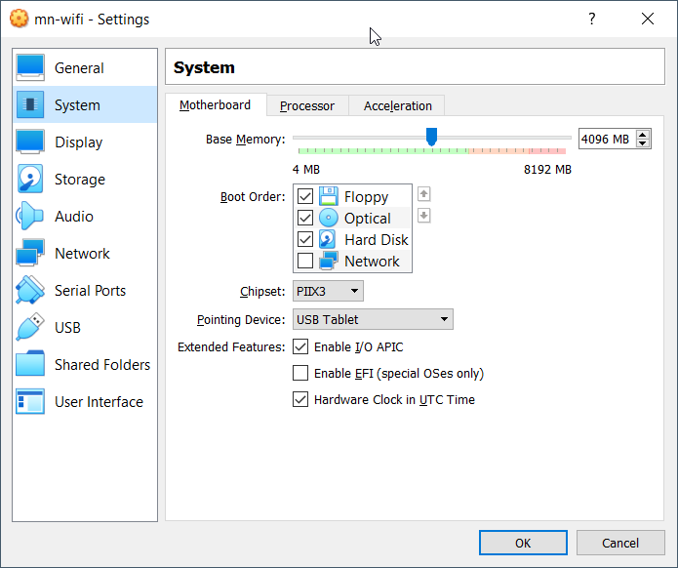
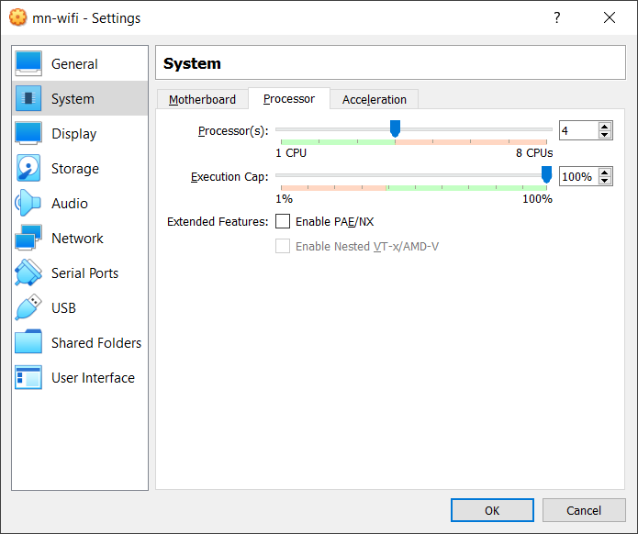
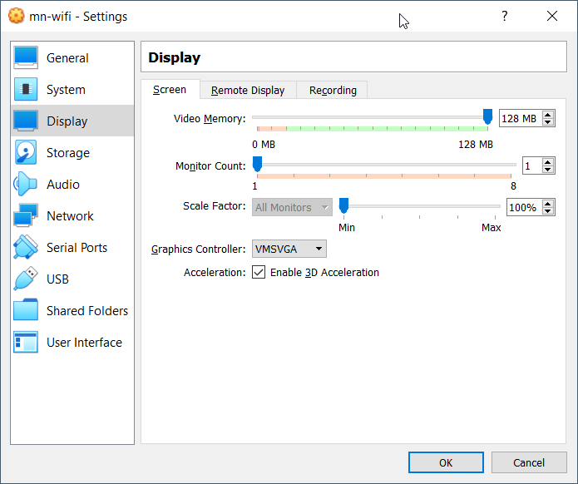
Configure the VM for best performance
Maximize available memory and CPU:
Select the VM (C34351VMv1) in VirtualBox’s window (left) and click on Settings (top)

Slide 12
Disable Linux’s built-in network manager
Linux has built-in network manager for autoconfiguration of network interfaces, associating with WiFi networks, obtaining IP-addresses via DHCP, etc.
Very nice for the ordinary user - but can be a royal pain in the a.. (pardon my french) if you want to control network interfaces manually (like in this exercise)
So a good habit is to disable it everytime you boot the virtual machine
Open a terminal (double-click on ‘Terminal Emulator’) and execute sudo systemctl stop NetworkManager.service
Password is user

Slide 13
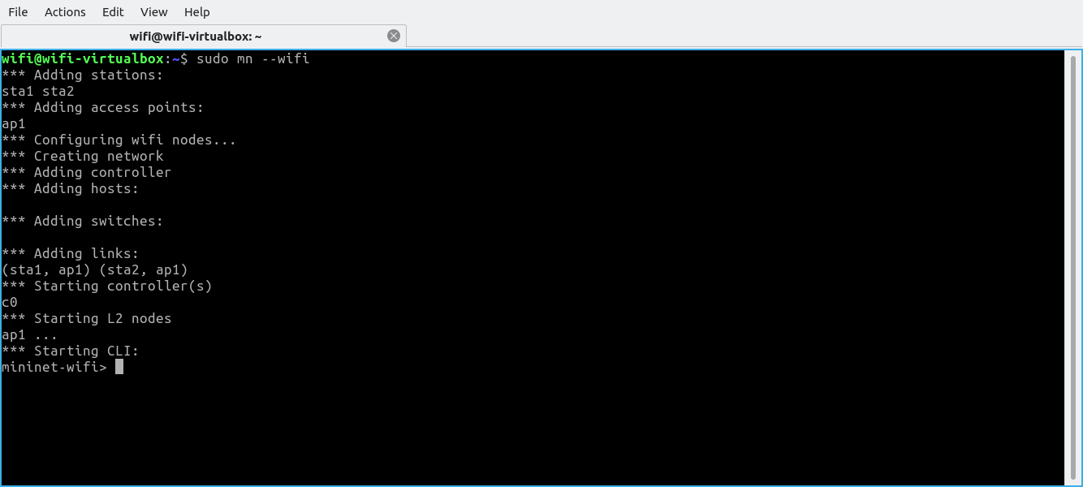
Mininet-WiFi tutorial (Step 1)
Start a terminal window and enter the command: sudo mn --wifi
Try to decode the output
Congratulations: Now you have a small WiFi network with an Access Point (ap1) and two stations (sta1 and sta2) running inside your computer
Note: User user has password user

Slide 14
Mininet-WiFi tutorial (Step 2)
Check connectivity: Use the command pingpair at the CLI
Can sta1 and sta2 communicate?
What are the IP-adresses of the stations?
sta1?
sta2?

Slide 15
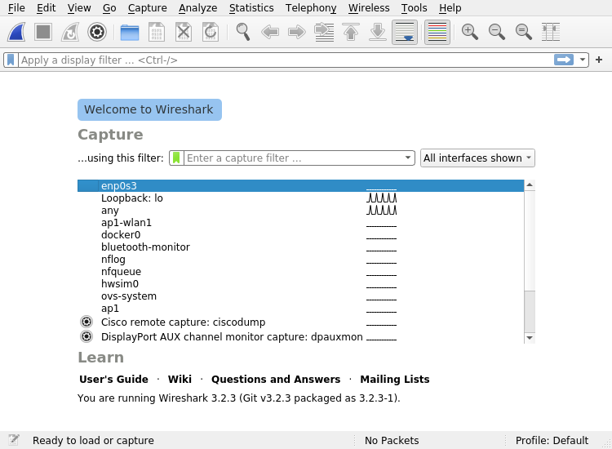
Mininet-WiFi tutorial (Step 3)
Start a new shell (Ctrl+Shift+T for a new tab or Ctrl+Shift+N for a new window)
In the new shell, start the Wireshark packet sniffer program: sudo wireshark

Slide 16
Mininet-WiFi tutorial (Step 4)
Double-click on the ap1-wlan1 interface to start capturing traffic from this interface
In the Mininet-WiFi CLI: sta1 ping sta2
Press Ctrl-C after some seconds to stop pinging
Switch to Wireshark and stop the capture
Look at the packets captured – are they as expected?

Slide 17
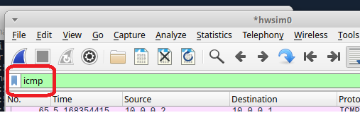
Mininet-WiFi tutorial (Step 5)
Enable the hwsim0 interface:
In the Mininet-WiFi CLI: sh ip link set dev hwsim0 up
Start a new capture in Wireshark using the hwsim0 interface
Generate ping-traffic as before - Stop the wireshark capture and look at the packets captured – what is different from the previous capture?
Don’t worry if you don’t understand what the extra packets are all about – we’ll cover that in next week’s lecture
Enter icmp in Wiresharks display filter:
Why are you seeing two ping requests and two replys every time?
Close Wireshark when you’re done

Slide 18
Mininet-WiFi tutorial (Step 6)
Start an Xterm session on sta2: xterm sta2
Use Ctrl + Rightclick in the xterm window to change font size
In the xterm window for sta2: iperf -s
In the normal Mininet-WiFi CLI: sta1 iperf -c sta2
Running this command takes approx. 10 seconds
How would you interpret the output?
Use iperf -c 10.0.0.2 if you run this in an XTerm on sta1
Note: We cannot start a program in the background from the CLI, so we’ll start an Xterm window first (on the relevant host) where we can execute the program.
Congratulations – You have completed the Mininet-WiFi tutorial and is now ready for the exciting two-part Mininet-WiFi exercise starting next week! ☺

Slide 19
Linux tips and tricks
Course 34351 Access- and Home Networks

Slide 20
Sharing files between the VM and the host (1)
Solution #1: Use the browser in the VM to upload files (screenshots, capture files from Wireshark, ...) to your cloud drive (Google Drive, Onedrive, ...) and use a browser in the host OS to download them again

Slide 21
Sharing files between the VM and the host (2a)
Solution #2: Insert a USB-drive (thumbdrive, ...) in your computer
In the VM’s VirtualBox menu, select Devices => USB and select your USB-device
After a short while, the USB-device should have been automatically mounted and accessible using the file manager

Slide 22
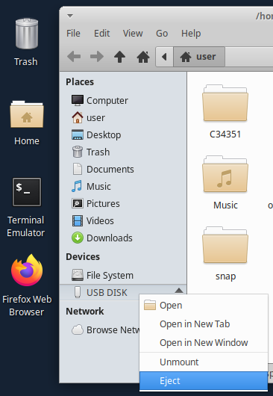
Sharing files between the VM and the host (2b)
Note: You must eject the USB drive from the VM before you can unselect it from VirtualBox
Right-click on the device in the File Manager and select Eject
Then unselect the device from VirtualBox:
Devices => USB and click on the USB-device to remove the checkmark
Sometimes you have to disconnect and reconnect the device to make it accessible in your host OS.
Note: Please do NOT use an USB-device with important stuff on it - this procedure may corrupt your USB-device it you’re unlucky

Slide 23
Miscellaneous
Changing keyboard layout:
Click on “mouse” at the top left and select Settings => Keyboard
Keyboard layout can be changed under the Layout tab
Changing the display resolution
Click on “mouse” at the top left and select Settings => Display
Select a suitable resolution for your computer and click Apply
And click “Keep ...” in the next dialog box if the resolution is to your liking
The application Screenshot (under Accessories) can be used to make screenshots
Wireshark can save captured traffic in *.pcap files for processing later
Even in your host OS if you have installed Wireshark here (but who hasn’t?)

Slide 24
How to get sudo to work without password
In a terminal window, enter the command: sudo visudo
You’ll probably need to provide the password ‘user’ this time
A text-editor called nano opens with the contents of the sudoers file
Scroll down to the end of the file and append the following line: user<tab>ALL = NOPASSWD: ALL
Note: <tab> is the tab(ulator) key, not the letters ‘<‘, ‘t’, ‘a’, ‘b’, ‘>
Save and exit with key sequence: Ctrl-o , <Enter> , Ctrl-x
Using sudo to run a command as superuser shouldn’t require a password any more

